Slide 1
Bayesian inversion and Bayesloc Multiple-Event Location
Performance Measures x.x, x.x, and x.x
Stephen C. Myers
LLNL Ground-based Nuclear Detonation Detection (GNDD)

Slide 2
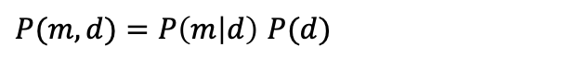
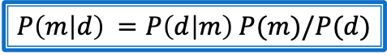
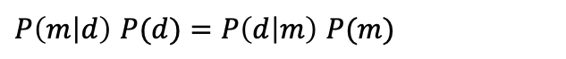
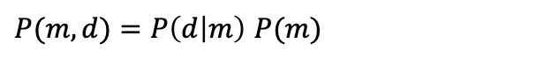
Bayes Theorem
We want to find the joint probability of the model (m) and the data (d)
Joint Model (m) and Data (d) Domain
Joint probability recast as conditional probability, model if data
P(m)
P(m,d)
$P(m,d)=P\left(m | d\right)$ $P(d)$
P(d)
Conditional probability can also be recast as data if model
$P(m,d)=P\left(d | m\right)$ $P(m)$
The conditional probabilities are equal
$P\left(m | d\right) P(d)=P\left(d | m\right)$ $P(m)$
Rearranging results in the common expression of Bayes Theorem
$P\left(m | d\right) =P\left(d | m\right)$ $P(m)/P(d)$
Let’s say P(m) and P(d) are constant in a defined area
Notes:
See https://www.probabilisitcworld.com/anatomy-bayes-theorem

Slide 3
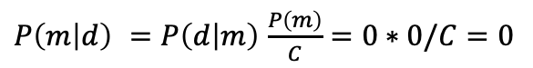
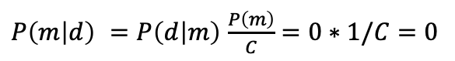
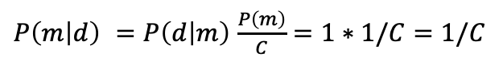
Grid-search Bayesian Inversion
We want to find the joint probability of the model (m) and the data (d)
Model (m) and Data (d) domain
Joint probability recast as conditional probability (model if data)
P(m)
P(m,d)
$P(m,d)=P\left(m | d\right)$ $P(d)$
P(d)
Conditional probability can also be recast as data if model
3
2
$P(m,d)=P\left(d | m\right)$ $P(m)$
The conditional probabilities are equal
1
$P\left(m | d\right) P(d)=P\left(d | m\right)$ $P(m)$
Rearranging results in the common expression of Bayes Theorem
$P\left(m | d\right) =P\left(d | m\right)$ $P(m)/P(d)$
We could grid the space and compute the probability
Point 1)
$P\left(m | d\right) =P\left(d | m\right)$ $\frac{P\left(m\right)}{C}=0∗1/C=0$
C is a normalizing constant =P(d)=
Sum(P(d|m)P(m))
Point 2)
$P\left(m | d\right) =P\left(d | m\right)$ $\frac{P\left(m\right)}{C}=0∗0/C=0$
$P\left(m | d\right) =P\left(d | m\right)$ $\frac{P\left(m\right)}{C}=1∗1/C=1/C$
It is easy to see that P(m|d) = 1/C for each point where P(m) and P(d) overlap
Point 3)
Notes:
For non-linear cases an inversions involving many model parameters there is a 3rd option…

Slide 4
Grid-search Bayesian Inversion
Grid search is an exhaustive approach.
It can be computationally prohibitive.
We want to find the joint probability of the model (m) and the data (d)
Model (m) and Data (d) domain
Joint probability recast as conditional probability (model if data)
P(m)
P(m,d)
$P(m,d)=P\left(m | d\right)$ $P(d)$
P(d)
Conditional probability can also be recast as data if model
3
2
$P(m,d)=P\left(d | m\right)$ $P(m)$
The conditional probabilities are equal
1
$P\left(m | d\right) P(d)=P\left(d | m\right)$ $P(m)$
Rearranging results in the common expression of Bayes Theorem
$P\left(m | d\right) =P\left(d | m\right)$ $P(m)/P(d)$
We could grid the space and compute the probability
Point 1)
$P\left(m | d\right) =P\left(d | m\right)$ $\frac{P\left(m\right)}{C}=0∗1/C=0$
C is a normalizing constant =P(d)=
Sum(P(d|m)P(m))
Point 2)
$P\left(m | d\right) =P\left(d | m\right)$ $\frac{P\left(m\right)}{C}=0∗0/C=0$
$P\left(m | d\right) =P\left(d | m\right)$ $\frac{P\left(m\right)}{C}=1∗1/C=1/C$
It is easy to see that P(m|d) = 1/C for each point where P(m) and P(d) overlap
Point 3)
Notes:
For non-linear cases an inversions involving many model parameters there is a 3rd option…

Slide 5
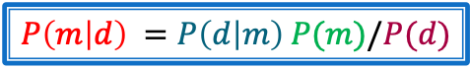
Bayesian inversion through sampling
Draw samples from the probability density function then infer the solution based on sample density: maximum likelihood point and uncertainty.
$P\left(m | d\right) =P\left(d | m\right)$ $P(m)/P(d)$
Notes:
See https://www.probabilisitcworld.com/anatomy-bayes-theorem

Slide 6
Bayesian inversion through sampling
Draw samples from the probability density function then infer the solution based on sample density: maximum likelihood point and uncertainty.
$P\left(m | d\right) =P\left(d | m\right)$ $P(m)/P(d)$
Advantages:
Explore large model space with fewer samples
Model space can be highly nonlinear and multi-modal
Notes:
See https://www.probabilisitcworld.com/anatomy-bayes-theorem

Slide 7




Bayesian inversion through sampling
$$P\left(m | d\right) Unknown$$
$$P\left(m\right) known$$
$P\left(m | d\right) =P\left(d | m\right)$ $P(m)/P(d)$
$$P\left(d | m\right) Can evaluate$$
$$P\left(d\right) Unknown$$
But how do you draw samples from a distribution you don’t know?
Notes:
See https://www.probabilisitcworld.com/anatomy-bayes-theorem

Slide 8
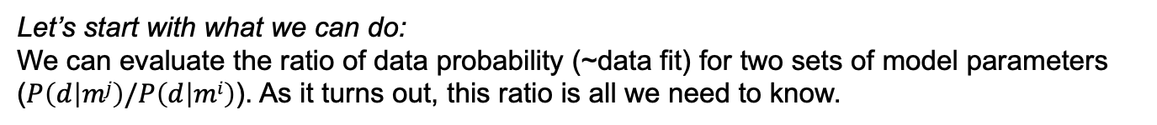
Bayesian inversion through sampling
$$P\left(m | d\right) Unknown$$
$$P\left(m\right) known$$
$P\left(m | d\right) =P\left(d | m\right)$ $P(m)/P(d)$
$$P\left(d | m\right) Can evaluate$$
$$P\left(d\right) Unknown$$
Let’s start with what we can do:
We can evaluate the ratio of data probability (~data fit) for two sets of model parameters ($P\left(d | mj\right)/P\left(d | mi\right)$). As it turns out, this ratio is all we need to know.
Notes:
See https://www.probabilisitcworld.com/anatomy-bayes-theorem

Slide 9

Bayesian inversion through sampling: Markov-Chain Monte Carlo
$$P\left(m | d\right) Unknown$$
$$P\left(m\right) Known$$
$P\left(m | d\right) =P\left(d | m\right)$ $P(m)/P(d)$
$$P\left(d | m\right) Can evaluate$$
$$P\left(d\right) Unknown$$
Let’s start with what we can do:
We can evaluate the ratio of data probability (~data fit) for two sets of model parameters ($P\left(d | mj\right)/P\left(d | mi\right)$). As it turns out, this ratio is all we need to know.
If we have a target distribution of model parameters (P(m) in this case) and we have a distribution that prescribes the probability of transitioning from one set of model parameters to a new set of parameters ($τ$(m,A)) within a subdomain A, then …
Proof (sorry about the change in notation)
∫_{ℝ} $τ$(m,A)P(m)dm->∫_{ℝ}p(x,A)π(x)dx=∫ℝd[∫Ap(x,y)1(x∉dy)dy+r(x)1(x∈dy)]π(x)dx=∫ℝd[∫Ap(x,y)1(x∉dy)dy]π(x)dx+∫ℝdr(x)1(x∈A)π(x)dx= ∫ℝd[∫Ap(x,y)1(x∉dy)dy]π(x)dx+
∫Ar(x)π(x)dx=∫A[∫ℝdp(x,y)π(y)dx]1(x∉dy)dy+∫Ar(x)π(x)dx=⋆∫A[∫ℝdp(y,x)π(x)dx]1(x∉dy)dy+∫Ar(x)π(x)dx=∫A(1−r(y))π(y)dy+∫Ar(x)π(x)dx
=∫_{A}P(m)dx.
Proof from Chib and Greenberg, Understanding the Metropolis-Hastings Algorithm, The American Statistician, 1995
Notes:
See https://www.probabilisitcworld.com/anatomy-bayes-theorem

Slide 10
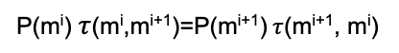
Bayesian inversion through sampling: Markov-Chain Monte Carlo
$$P\left(m | d\right) Unknown$$
$$P\left(m\right) Known$$
$P\left(m | d\right) =P\left(d | m\right)$ $P(m)/P(d)$
$$P\left(d | m\right) Can evaluate$$
$$P\left(d\right) Unknown$$
Let’s start with what we can do:
We can evaluate the ratio of data probability (~data fit) for two sets of model parameters ($P\left(d | mj\right)/P\left(d | mi\right)$). As it turns out, this ratio is all we need to know.
If we have a target distribution of model parameters (P(m) in this case) and we have a distribution that prescribes the probability of transitioning from one set of model parameters to a new set of parameters ($τ$(m,A)) within a subdomain A, then …
Proof (sorry about the change in notation)
∫_{ℝ} $τ$(m,A)P(m)dx->∫_{ℝ}p(x,A)π(x)dx=∫ℝd[∫Ap(x,y)1(x∉dy)dy+r(x)1(x∈dy)]π(x)dx=∫ℝd[∫Ap(x,y)1(x∉dy)dy]π(x)dx+∫ℝdr(x)1(x∈A)π(x)dx= ∫ℝd[∫Ap(x,y)1(x∉dy)dy]π(x)dx+
∫Ar(x)π(x)dx=∫A[∫ℝdp(x,y)π(y)dx]1(x∉dy)dy+∫Ar(x)π(x)dx=⋆∫A[∫ℝdp(y,x)π(x)dx]1(x∉dy)dy+∫Ar(x)π(x)dx=∫A(1−r(y))π(y)dy+∫Ar(x)π(x)dx
=∫_{A}P(m)dx.
This step requires that the proposal meets the detailed balance condition
P(m^{i}) $τ$(m^{i},m^{i+1})=P(m^{i+1})$τ$(m^{i+1}, m^{i})
Proof from Chib and Greenberg, Understanding the Metropolis-Hastings Algorithm, The American Statistician, 1995
Notes:
See https://www.probabilisitcworld.com/anatomy-bayes-theorem

Slide 11
Bayesian inversion through sampling: Markov-Chain Monte Carlo
$$P\left(m | d\right) Unknown$$
$$P\left(m\right) Known$$
$P\left(m | d\right) =P\left(d | m\right)$ $P(m)/P(d)$
$$P\left(d | m\right) Can evaluate$$
$$P\left(d\right) Unknown$$
Let’s start with what we can do:
We can evaluate the ratio of data probability (~data fit) for two sets of model parameters ($P\left(d | mj\right)/P\left(d | mi\right)$). As it turns out, this ratio is all we need to know.
If we have a target distribution of model parameters (P(m) in this case) and we have a distribution that prescribes the probability of transitioning from one set of model parameters to a new set of parameters ($τ$(m,A)) within a subdomain A, then …
Proof (sorry about the change in notation)
∫_{ℝ} $τ$(m,A)P(m)dx->∫_{ℝ}p(x,A)π(x)dx=∫ℝd[∫Ap(x,y)1(x∉dy)dy+r(x)1(x∈dy)]π(x)dx=∫ℝd[∫Ap(x,y)1(x∉dy)dy]π(x)dx+∫ℝdr(x)1(x∈A)π(x)dx= ∫ℝd[∫Ap(x,y)1(x∉dy)dy]π(x)dx+
∫Ar(x)π(x)dx=∫A[∫ℝdp(x,y)π(y)dx]1(x∉dy)dy+∫Ar(x)π(x)dx=⋆∫A[∫ℝdp(y,x)π(x)dx]1(x∉dy)dy+∫Ar(x)π(x)dx=∫A(1−r(y))π(y)dy+∫Ar(x)π(x)dx
=∫_{A}P(m)dx.
This step requires that the proposal meets the detailed balance condition
P(m^{i}) $τ$(m^{i},m^{i+1})=P(m^{i+1})$τ$(m^{i+1}, m^{i})
What does this say?
If we conditionally sample P(m|d) with a model parameter transition kernel that satisfies the detailed balance condition, then the resulting Markov Chain will sample the stationary distribution of P(m|d).
Proof from Chib and Greenberg, Understanding the Metropolis-Hastings Algorithm, The American Statistician, 1995
Notes:
See https://www.probabilisitcworld.com/anatomy-bayes-theorem

Slide 12
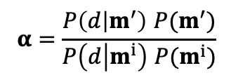
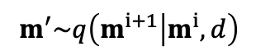
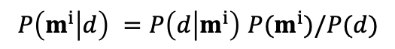
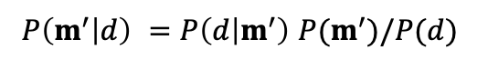
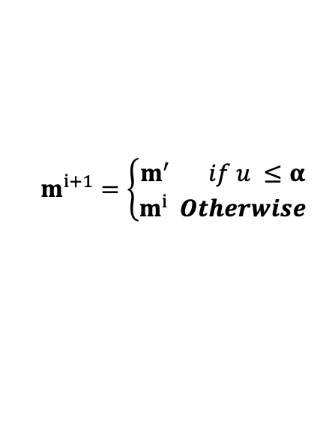
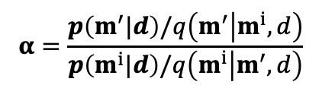
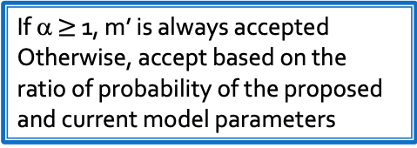
There are several commonly used transition kernels: Metropolis-Hastings
Metropolis-Hastings
Transition probability (proposing a new point)
Compute acceptance ratio
Generate u~ Uniform([0,1])
$$m^{′}\sim q\left(m^{i+1} | m^{i},d\right)$$
q is a proposal distribution. Often a “random walk” (Gaussian).
Evaluate using Bayes Theorem
$$α=\frac{p\left(m^{′}|d\right)/q\left(m^{′} | m^{i},d\right)}{p\left(m^{i}|d\right)/q\left(m^{i} | m^{′},d\right)}$$
$$P\left(m^{′} | d\right) =P\left(d | m^{′}\right) P(m^{′})/P(d)$$
$$P\left(m^{i} | d\right) =P\left(d | m^{i}\right) P(m^{i})/P(d)$$
$$α=\frac{P\left(d | m^{′}\right) P(m^{′})}{P\left(d | m^{i}\right) P(m^{i})}$$
The P(d) terms cancel!
If q is symmetric (e.g. Gaussian), the q terms cancel
$$m^{i+1}=\left\{\begin{matrix}m^{′} if u ≤α \\ m^{i} Otherwise\end{matrix}\right.$$
If α $≥$ 1, m’ is always accepted
Otherwise, accept based on the ratio of probability of the proposed and current model parameters

Slide 13
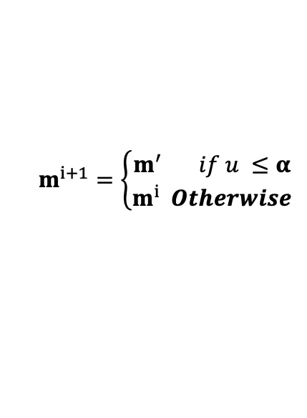
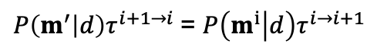
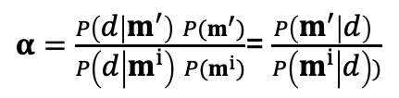
Metropolis-Hastings: Step through a proposal
Example
Transition kernel (τ)
P(m)
$P\left(m^{′} | d\right)τ^{i+1→i}$= $P\left(m^{i} | d\right)τ^{i→i+1}$
P(m^{i+1})
P(m^{i})
m^{i}
m^{i+1}
Recall the proposal procedure
$α=\frac{P\left(d | m^{′}\right) P(m^{′})}{P\left(d | m^{i}\right) P(m^{i})}$= $\frac{P\left(m^{′} | d\right) }{P\left(m^{i} | d\right))}$
u~ Uniform([0,1])
$$m^{i+1}=\left\{\begin{matrix}m^{′} if u ≤α \\ m^{i} Otherwise\end{matrix}\right.$$

Slide 14
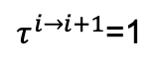
Probability of the proposal is higher so accept it
Example
Transition kernel (τ)
P(m)
$P\left(m^{′} | d\right)τ^{i+1→i}$= $P\left(m^{i} | d\right)τ^{i→i+1}$
P(m^{i+1})
For our example
P(m^{i})
$τ^{i→i+1}$=1
m^{i}
m^{i+1}
Recall the proposal procedure
$α=\frac{P\left(d | m^{′}\right) P(m^{′})}{P\left(d | m^{i}\right) P(m^{i})}$= $\frac{P\left(m^{′} | d\right) }{P\left(m^{i} | d\right))}$
u~ Uniform([0,1])
$$m^{i+1}=\left\{\begin{matrix}m^{′} if u ≤α \\ m^{i} Otherwise\end{matrix}\right.$$

Slide 15
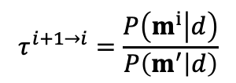
What if we reversed the proposal?
Example
Transition kernel (τ)
P(m)
$P\left(m^{′} | d\right)τ^{i+1→i}$= $P\left(m^{i} | d\right)τ^{i→i+1}$
P(m^{i+1})
For our example
P(m^{i})
$τ^{i→i+1}$=1
So
m^{i}
m^{i+1}
$$τ^{i+1→i}=\frac{P\left(m^{i} | d\right)}{P\left(m^{′} | d\right)}$$
This is the reversed proposal proposition
Recall the proposal procedure
$α=\frac{P\left(d | m^{′}\right) P(m^{′})}{P\left(d | m^{i}\right) P(m^{i})}$= $\frac{P\left(m^{′} | d\right) }{P\left(m^{i} | d\right))}$
u~ Uniform([0,1])
$$m^{i+1}=\left\{\begin{matrix}m^{′} if u ≤α \\ m^{i} Otherwise\end{matrix}\right.$$

Slide 16
Metropolis-Hastings sampling satisfies the detailed balance condition
Example
Transition kernel (τ)
P(m)
$P\left(m^{′} | d\right)τ^{i+1→i}$= $P\left(m^{i} | d\right)τ^{i→i+1}$
P(m^{i+1})
For our example
P(m^{i})
$τ^{i→i+1}$=1
So
m^{i}
m^{i+1}
$$τ^{i+1→i}=\frac{P\left(m^{i} | d\right)}{P\left(m^{′} | d\right)}$$
This is the reversed proposal proposition
Recall the proposal procedure
$α=\frac{P\left(d | m^{′}\right) P(m^{′})}{P\left(d | m^{i}\right) P(m^{i})}$= $\frac{P\left(m^{′} | d\right) }{P\left(m^{i} | d\right))}$
u~ Uniform([0,1])
Metropolis-Hastings meets the detailed balance condition, by design
$$m^{i+1}=\left\{\begin{matrix}m^{′} if u ≤α \\ m^{i} Otherwise\end{matrix}\right.$$

Slide 17
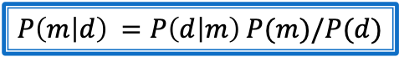
MCMC with our cartoon inversion
$P\left(m | d\right) =P\left(d | m\right)$ $P(m)/P(d)$
Model (m) and Data (d) domain
P(m)
Markov-Chain Monte Carlo
P(m,d)
Accept 3
P(d)
Start at some point m⁰
Propose a new point in model space
If the new point is higher probability accept it, becomes m⁰⁺¹
If new point is lower probability, accept it a ratio proportional to the probability of the current and proposed state, selected point becomes new state m⁰⁺¹
Repeat until samples adequately characterize P(m|d).
Density of accepted points infers P(m|d)
Reject 1
Reject 2
start

Slide 18
Metropolis-Hastings: Advantage
The power of Metropolis-Hastings is that we don’t need to know the analytical form of P(m|d). We only need to evaluate it, P(m|d)=P(d|m)P(m)
P(m|d)
P(m^{i+1})
P(m^{i})
m^{i}
m^{i+1}

Slide 19
Metropolis-Hastings: Disadvantage
The power of Metropolis-Hastings is that we don’t need to know the analytical form of P(m|d). We only need to evaluate it, P(m|d)=P(d|m)P(m)
The disadvantage is that the M-H can be inefficient if the proposal is poorly tuned.
P(m|d)
P(m|d)
P(m^{i+1})
P(m^{i})
P(m^{i})
P(m^{i+1})
m^{i+1}
m^{i}
m^{i}
m^{i+1}
What if the proposal step is too large?
New proposals will tend to be on the tails of the distribution and, therefore, rejected. Many more iterations are needed…

Slide 20
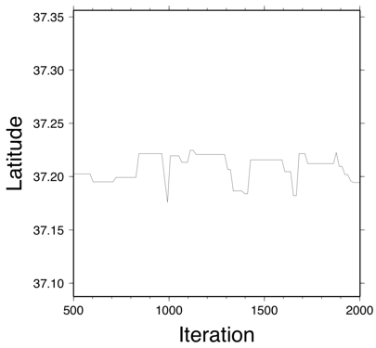
Metropolis-Hastings: Disadvantage
The disadvantage is that the M-H can be inefficient if the proposal is poorly tuned.
Example of inefficient sampling
P(m|d)
P(m^{i})
P(m^{i+1})
m^{i+1}
m^{i}
What if the proposal step is too large?
New proposals will tend to be on the tails of the distribution and, therefore, rejected. Many more iterations are needed…

Slide 21
The power of Metropolis-Hastings is that we don’t need to know the analytical form of P(m|d). We only need to evaluate it, P(m|d)=P(d|m)P(m)
If we know the analytical form of P(m|d), we can sample it directly for each step of the MCMC iteration.
P(m|d)
P(m|d)
P(m^{i+1})
P(m^{i})
m^{i}
m^{i+1}
m

Slide 22
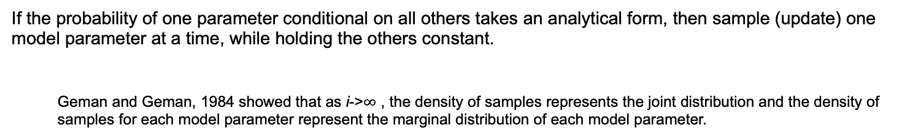
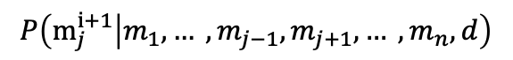
Gibbs sampling
If the probability of one parameter conditional on all others takes an analytical form, then sample (update) one model parameter at a time, while holding the others constant.
Geman and Geman, 1984 showed that as i->$∞$ , the density of samples represents the joint distribution and the density of samples for each model parameter represent the marginal distribution of each model parameter.
$$P\left(m_{j}^{i+1} | m_{1}, … ,m_{j−1},m_{j+1}, … ,m_{n},d\right)$$

Slide 23
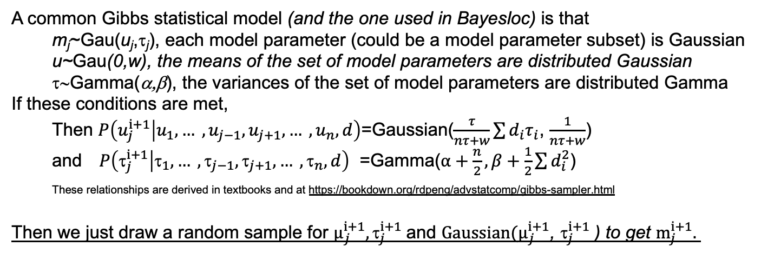
Gibbs sampling
If the probability of one parameter conditional on all others takes an analytical form, then sample (update) one model parameter at a time, while holding the others constant.
Geman and Geman, 1984 showed that as i->$∞$ , the density of samples represents the joint distribution and the density of samples for each model parameter represent the marginal distribution of each model parameter.
$$P\left(m_{j}^{i+1} | m_{1}, … ,m_{j−1},m_{j+1}, … ,m_{n},d\right)$$
A common Gibbs statistical model (and the one used in Bayesloc) is that
m_{j}~Gau(u_{j},τ_{j}), each model parameter (could be a model parameter subset) is Gaussian
u~Gau(0,w), the means of the set of model parameters are distributed Gaussian
τ∼Gamma(α,β), the variances of the set of model parameters are distributed Gamma
If these conditions are met,
Then $P\left(u_{j}^{i+1} | u_{1}, … ,u_{j−1},u_{j+1}, … ,u_{n},d\right)$=Gaussian($\frac{τ}{nτ+w}\sum{d_{i}τ_{i}}$, $\frac{1}{nτ+w}$)
and $P\left({\text{t}}_{j}^{i+1} | {\text{t}}_{1}, … ,{\text{t}}_{j−1},{\text{t}}_{j+1}, … ,{\text{t}}_{n},d\right)$ =Gamma($α+\frac{n}{2},β+\frac{1}{2}\sum{d_{i}^{2}}$)
These relationships are derived in textbooks and at https://bookdown.org/rdpeng/advstatcomp/gibbs-sampler.html
Then we just draw a random sample for $μ_{j}^{i+1}, {\text{t}}_{j}^{i+1}$and $Gaussian(μ_{j}^{i+1}$, ${\text{t}}_{j}^{i+1}$) to get ${\text{m}}_{j}^{i+1}.$

Slide 24
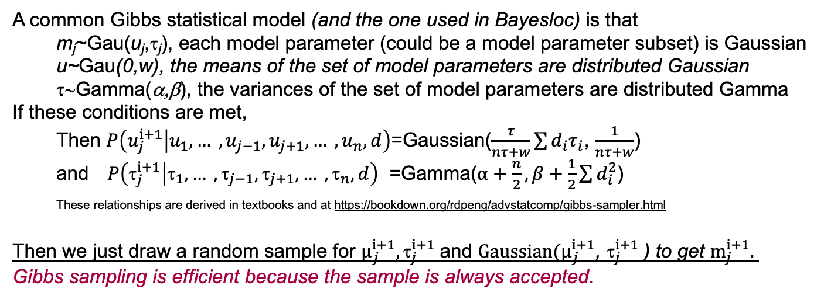
Gibbs sampling
If the probability of one parameter conditional on all others takes an analytical form, then sample (update) one model parameter at a time, while holding the others constant.
Geman and Geman, 1984 showed that as i->$∞$ , the density of samples represents the joint distribution and the density of samples for each model parameter represent the marginal distribution of each model parameter.
$$P\left(m_{j}^{i+1} | m_{1}, … ,m_{j−1},m_{j+1}, … ,m_{n},d\right)$$
A common Gibbs statistical model (and the one used in Bayesloc) is that
m_{j}~Gau(u_{j},τ_{j}), each model parameter (could be a model parameter subset) is Gaussian
u~Gau(0,w), the means of the set of model parameters are distributed Gaussian
τ∼Gamma(α,β), the variances of the set of model parameters are distributed Gamma
If these conditions are met,
Then $P\left(u_{j}^{i+1} | u_{1}, … ,u_{j−1},u_{j+1}, … ,u_{n},d\right)$=Gaussian($\frac{τ}{nτ+w}\sum{d_{i}τ_{i}}$, $\frac{1}{nτ+w}$)
and $P\left({\text{t}}_{j}^{i+1} | {\text{t}}_{1}, … ,{\text{t}}_{j−1},{\text{t}}_{j+1}, … ,{\text{t}}_{n},d\right)$ =Gamma($α+\frac{n}{2},β+\frac{1}{2}\sum{d_{i}^{2}}$)
These relationships are derived in textbooks and at https://bookdown.org/rdpeng/advstatcomp/gibbs-sampler.html
Then we just draw a random sample for $μ_{j}^{i+1}, {\text{t}}_{j}^{i+1}$and $Gaussian(μ_{j}^{i+1}$, ${\text{t}}_{j}^{i+1}$) to get ${\text{m}}_{j}^{i+1}.$
Gibbs sampling is efficient because the sample is always accepted.

Slide 25
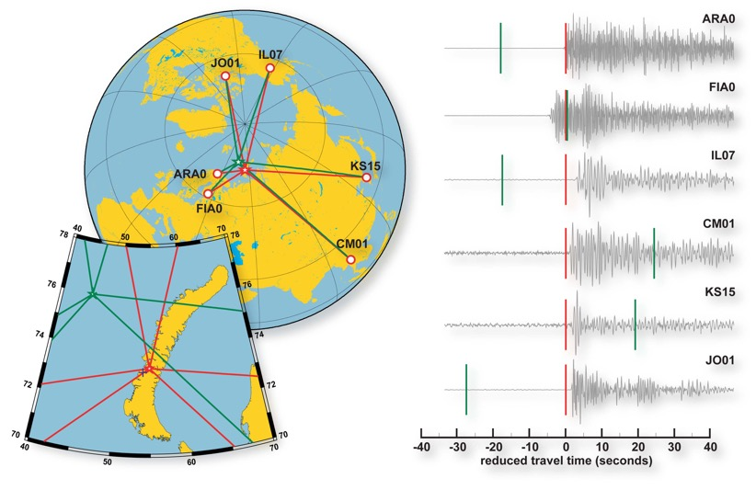
Let’s apply MCMC to event location
The goal is to find the location and time that minimizes the difference between observed and predicted arrivals
Notes:
Our goal is to find the 3d location and the time of an event that minimizes the difference between observed and predicted arrival times.

Slide 26
Bayesloc models the multiple-event system
Event locations and origin times
Travel time predictions
Regional travel time bias
Path specific error
Arrival time measurements (precision)
Arrival time phase assignment
Modeling the whole system enables accurate error characterization

Slide 27
Bayesloc: conditional probability
We have arrival times for various phases.
We would like to know:
Event locations.
Travel times.
Measurement precision and phase labels.
o = origin time
x = location
T = phase travel times
W = phase labels
σ = measurement precision
= travel time error
a = observed arrival times
w = input phase labels
Statistical model

Slide 28
Bayesloc: Bayesian formulation
Bayesian formulation recasts the conditional probability into a collection of forward calculations.
Bayesloc probability model
Travel time prediction conditional on model and corrections
Measurement precision and travel time correction priors
Arrivals conditional on a hypothesized set of event locations
Phase labels conditional on input labels
Parameters
conditional on data
=
Hypocenter priors

Slide 29
Bayesloc: measurement uncertainty model
Error decomposition
• Precision (1/Variance)
• (W) phase
• (j) event
• (i) station

Slide 30
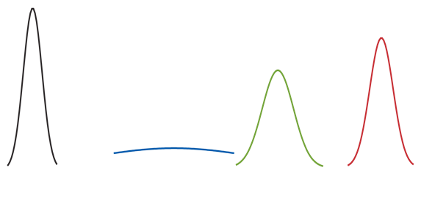
Bayesloc: measurement uncertainty model
Error decomposition
• Precision (1/Variance)
• (W) phase
• (j) event
• (i) station
Example probability density
σ = 0.6s
σ = 5.0s
σ = 1.0s
σ = 0.75s
Product of precisions down weights components with large variance.
Datum (ijw)
=
Station (i)
*
Event (j)
*
Phase(w)
30

Slide 31
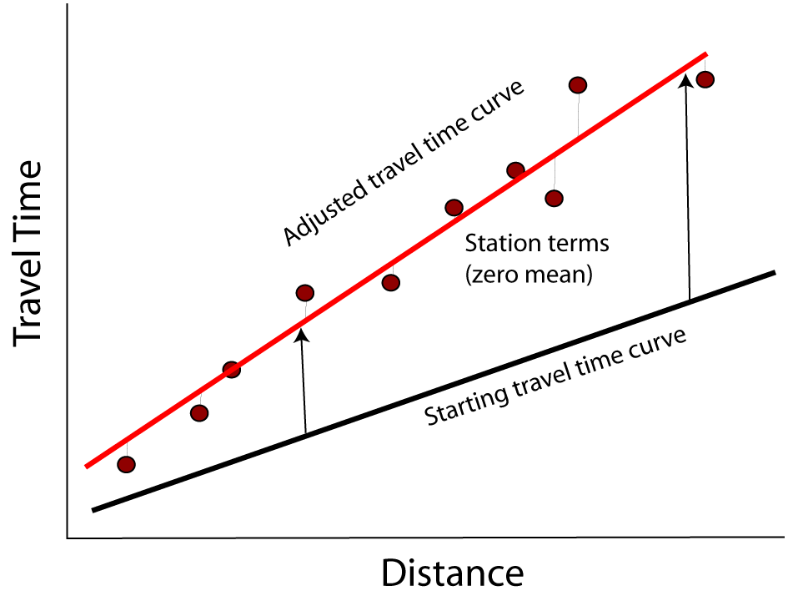
Bayesloc: travel-time model
Travel time decomposition
• (M) model prediction
• (α, β) travel-time curve adjustments
• (γ) station (i), station-phase (iW), and event (j) adjustments allow for path-specific corrections.
Constraining the station- and event-specific corrections to have mean=0, enables resolution of absolute location.

Slide 32
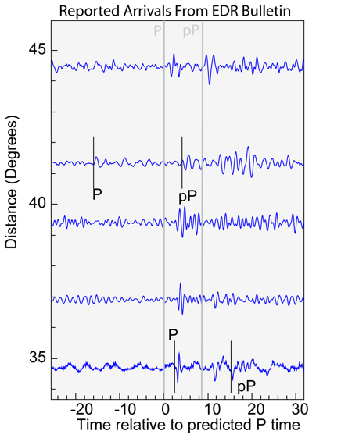
Bayesloc Forward Problems: Phase Labels
Probability of phase labels given a set of observed arrival times, locations, phase labels, travel time predictions and measurement uncertainties
o = origin times
x = locations
T = phase travel times
W = phase labels
= measurement precisions (pick)
V = measurement precisions (diff)
τ = travel time corrections
a = arrival times (picks)
d = differential arrival times
w = input phase labels

Slide 33

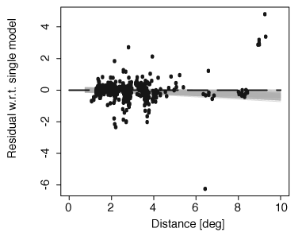
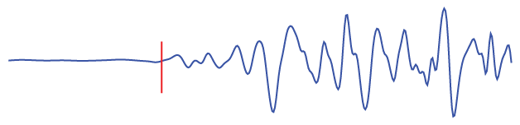
Bayesloc Forward Problems: Prior Constraints
Input prior probabilities.
Mine event
Travel time
prediction prior
o = origin times
x = locations
T = phase travel times
W = phase labels
= measurement precisions (pick)
V = measurement precisions (diff)
τ = travel time corrections
a = arrival times (picks)
d = differential arrival times
w = input phase labels
Pick uncertainty prior

Slide 34
Progressive Sampling of Bayesloc Parameters
Different sampling methods are used for efficiency
Locations
(Metropolis-Hastings)
Measurement error
(Gibbs+Slice)
Origin Times
(Gibbs)
Phase labels
(Gibbs)
Travel Time Corrections
(Gibbs)
First ~200 iterations Only sample event locations
~200 to ~300 Add sampling of measurement precision and phase labels
~400 to N Add sampling of travel time corrections

Slide 35
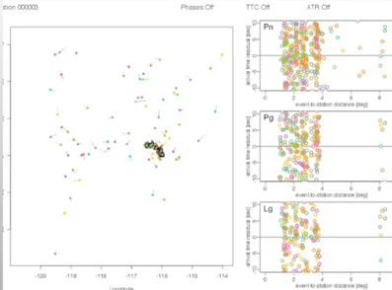
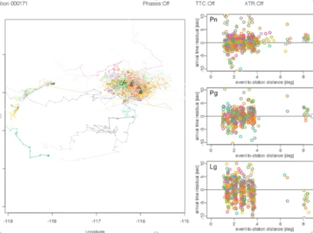
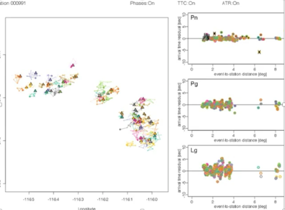
Bayesloc: Markov-Chain Monte Carlo
0) Start
Movie shows the sampling of event locations.
Phase residuals for each MCMC step are shown to the right
1) Burn in
2) sample

Slide 36
Analysis of MCMC samples: Option 1 (preferred)
Compute point density (heat plot)
Contour point density
The area inside a contour can be assigned a probability level

Slide 37
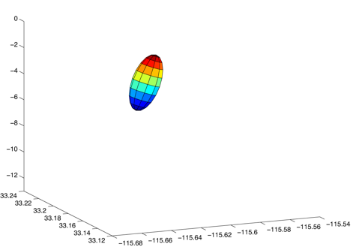
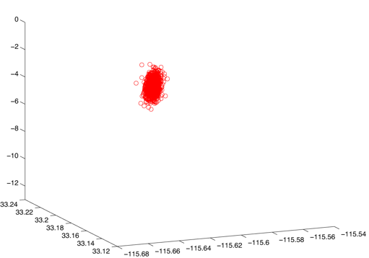
Analysis of MCMC samples: Option 2
Assume Gaussian distribution
Computer sample mean (e.g. epicenter)
Computer ellipse/ellipsoid using sample covariance
Note that correlation/covariance of all Bayesloc parameters can be examined in a similar fashion.
Ellipsoid
3D samples
Depth (km)
Latitude
Longitude

Slide 38
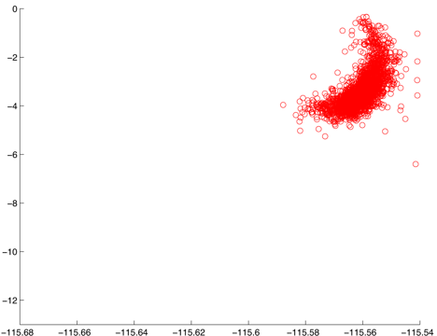
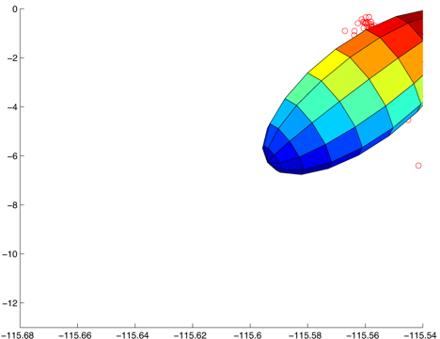
Analysis of MCMC samples: Option 2 (Caveat)
MCMC samples may not conform to a Gaussian distribution
Non-Gaussian sample distribution
Depth (km)
Ellipsoid not a good representation of uncertainty for this example
Longitude

Slide 39
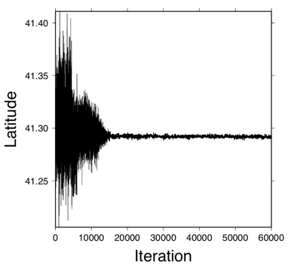
A note on MCMC: Chain Mixing
The Markov-Chain Represents the distribution when it is “well mixed”
Well mixed means that the chain has reached a steady state.
Think of it as answering the question, “would a subsample give approximately the same answer?”
Throw away the “burn in” period
Not mixed
mixed

Slide 40
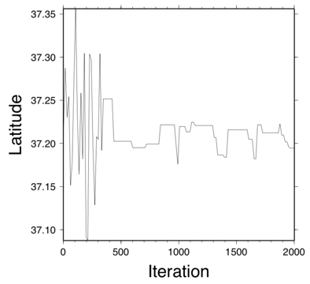
A note on MCMC: Chain Mixing
The Markov-Chain Represents the distribution when it is “well mixed”
Well mixed means that the chain has reached a steady state.
Think of it as answering the question, “would a subsample give approximately the same answer?”
Throw away the “burn in” period
Inefficient sampling: either need to improve sampling efficiency or run an order of magnitude (or more) iterations
Not mixed
mixed
Not mixed

Slide 41
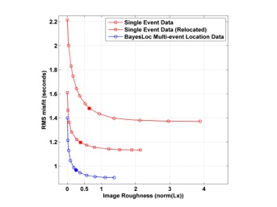
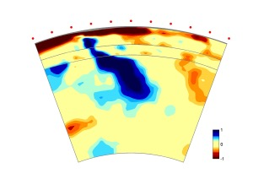
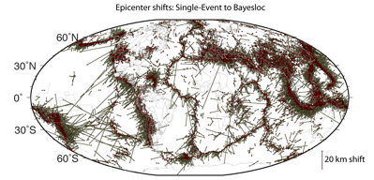
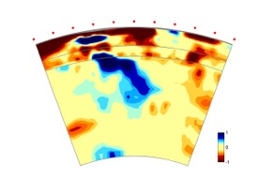
Some examples of Bayesloc applications: Tomography Data
Relocate global seismicity
Myers et al., 2011 JGR
Tomographic model is smoother and better fits the data
Simmons et al., 2011 (JGR), 2012 (JGR), 2015 (GRL)
Example of image difference
Simmons et al., 2012
Bayesloc dataset based
Dataset based on iterative relocation

Slide 42
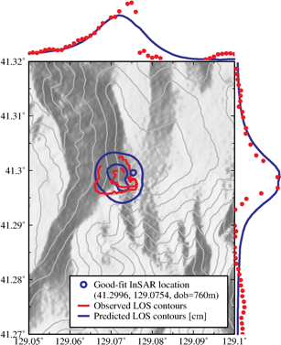
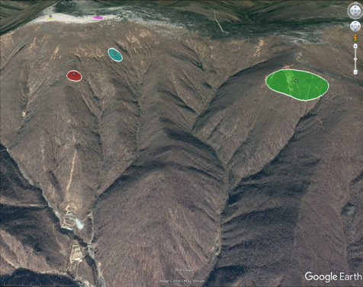
Some examples of Bayesloc applications: Using Priors
Constraint on the January 2016 DPRK nuclear test based on InSAR and finite-element modeling
Use the InSAR-based constraint to locate the other DPRK tests
2016_09
2016_01
2009
2013
2006
Adit for 2009
2013
2016
Adit for 2006
Depths ~1 km ± 1
95% coverage ellipse ~0.2 km²
The events are constrained to specific spots on the mountain
Myers et al., 2018, SRL

Slide 43
Summary
Bayesian inversion
Enables probabilistic prior constraints
Lends itself to stochastic solvers (MCMC)
High-dimensional spaces
Non-linear
Non-parametric
Caveats
Better for computationally cheap forward problems
Theoretically represents the joint probability density when the number of samples is infinite.
Good approximation when chain is well mixed.

Slide 44
Resources
Download:
https://www-gs.llnl.gov/nuclear-threat-reduction/nuclear-explosion-monitoring/bayesloc
Includes user manual and example data sets
Papers (Myers et al., 2007,2009, 2011, 2018)

